Slide 1

CS47: Cross-Platform Mobile Development
Lecture 8A: Firebase Database
Faculty Advisor
Instructor #1
Fall 2019
https://class.website
class.slack.com

Slide 2

Exercise
STARTER CODE

Slide 3
Where We Are
Single view with no storage
Single view with local storage
Multiple view with local storage
Multiple view with networking
USEFUL LINKS / Lecture 5A
Notes:
App has only one page with no database
App has only one page with a local database
App has multiple pages with a local database
TODAY!

Slide 4
Where We Are
Single view with no storage
Single view with local storage
Multiple view with local storage
Multiple view with networking
USEFUL LINKS / Lecture 5A

Slide 5
Local Data | Network Data
Performance and size are usually not an issue | Fetches are tailored to what is needed
Delivery is guaranteed . | Delivery depends on network .
Typically accessed by one session . of the app at a time | Accessed by unknown number of sessions of the app at a time
Doesn’t worry about concurrency | Concurrency is at the heart of it
Notes:
Network Data:
Fetches need to be tailored because it’s expensive to make requests over the Internet (you don’t want to wait for data only to find that it’s not exactly what you wanted)
Delivery depends on your Internet connection

Slide 6
Firebase

Slide 7


Overview for Today
Firebase Overview
Firebase Cloud Firestore
Firebase Authentication
Firebase Exercise

Slide 8
What is Firebase?
It’s amazing.
Literally the greatest thing in the world.
Period.
EOM.
Backend-as-a-Service (BaaS)
Allows developers to focus on frontend
Database management, user authentication, etc.
USEFUL LINKS / Firebase Website / What is BaaS?

Slide 9


What is Firebase?
I’ll take care of everything!
Response
Request
USEFUL LINKS / Firebase Website / What is BaaS?
Notes:
Open website to demonstrate with Firebase products

Slide 10
Overview for Today
Firebase Overview
Firebase Cloud Firestore
Firebase Authentication
Firebase Exercise

Slide 11
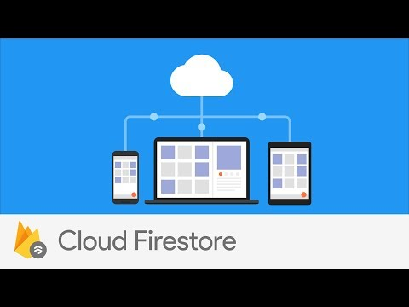
What is Firebase Cloud Firestore?
USEFUL LINKS / Firebase Cloud Firestore Docs

Slide 12
How do you use Firebase Cloud Firestore?
Install Firebase ( npm install --save firebase )
USEFUL LINKS / Firebase Cloud Firestore Docs

Slide 13
How do you use Firebase Cloud Firestore?
Install Firebase ( npm install --save firebase )
Create a Firebase project
USEFUL LINKS / Firebase Cloud Firestore Docs

Slide 14
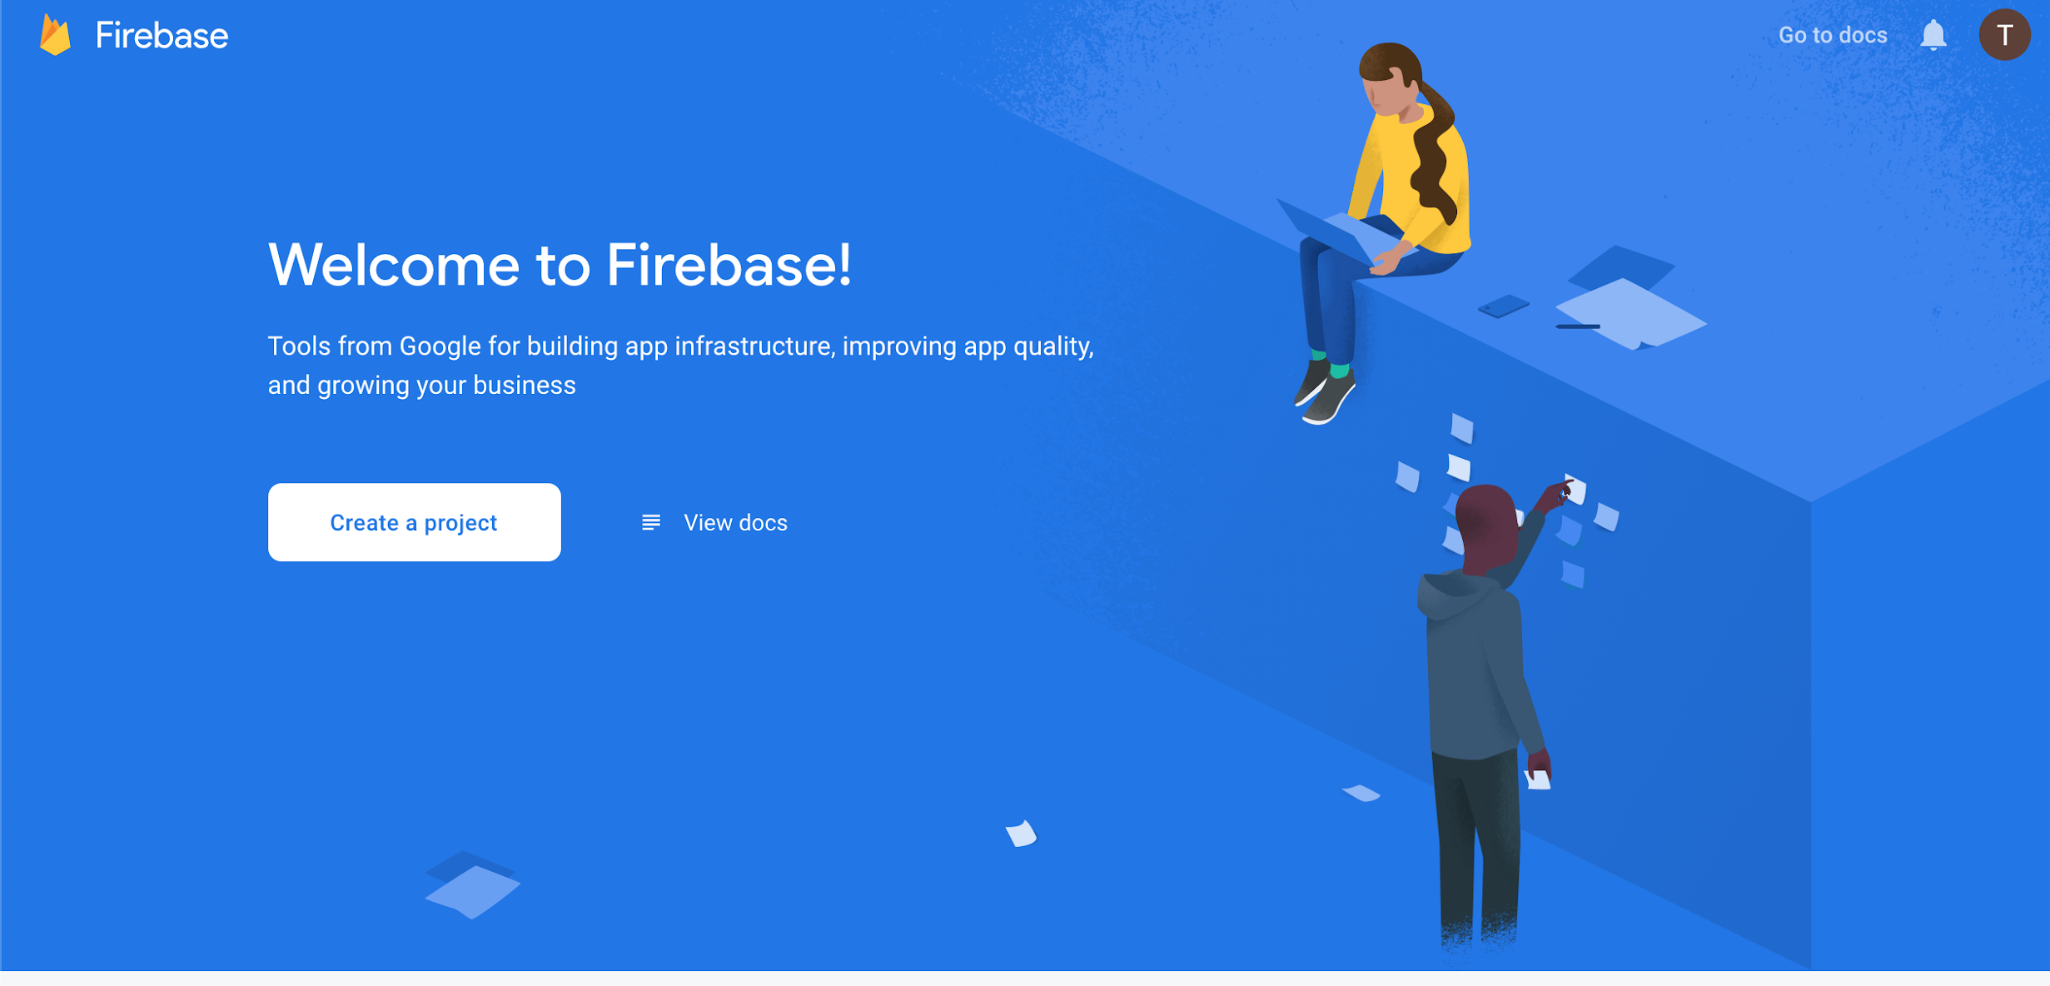
1
console.firebase.google.com
Notes:
Follow along! Note that you will want to use a personal email (not your Stanford one) so that you can continue to access your Firebase projects.

Slide 15
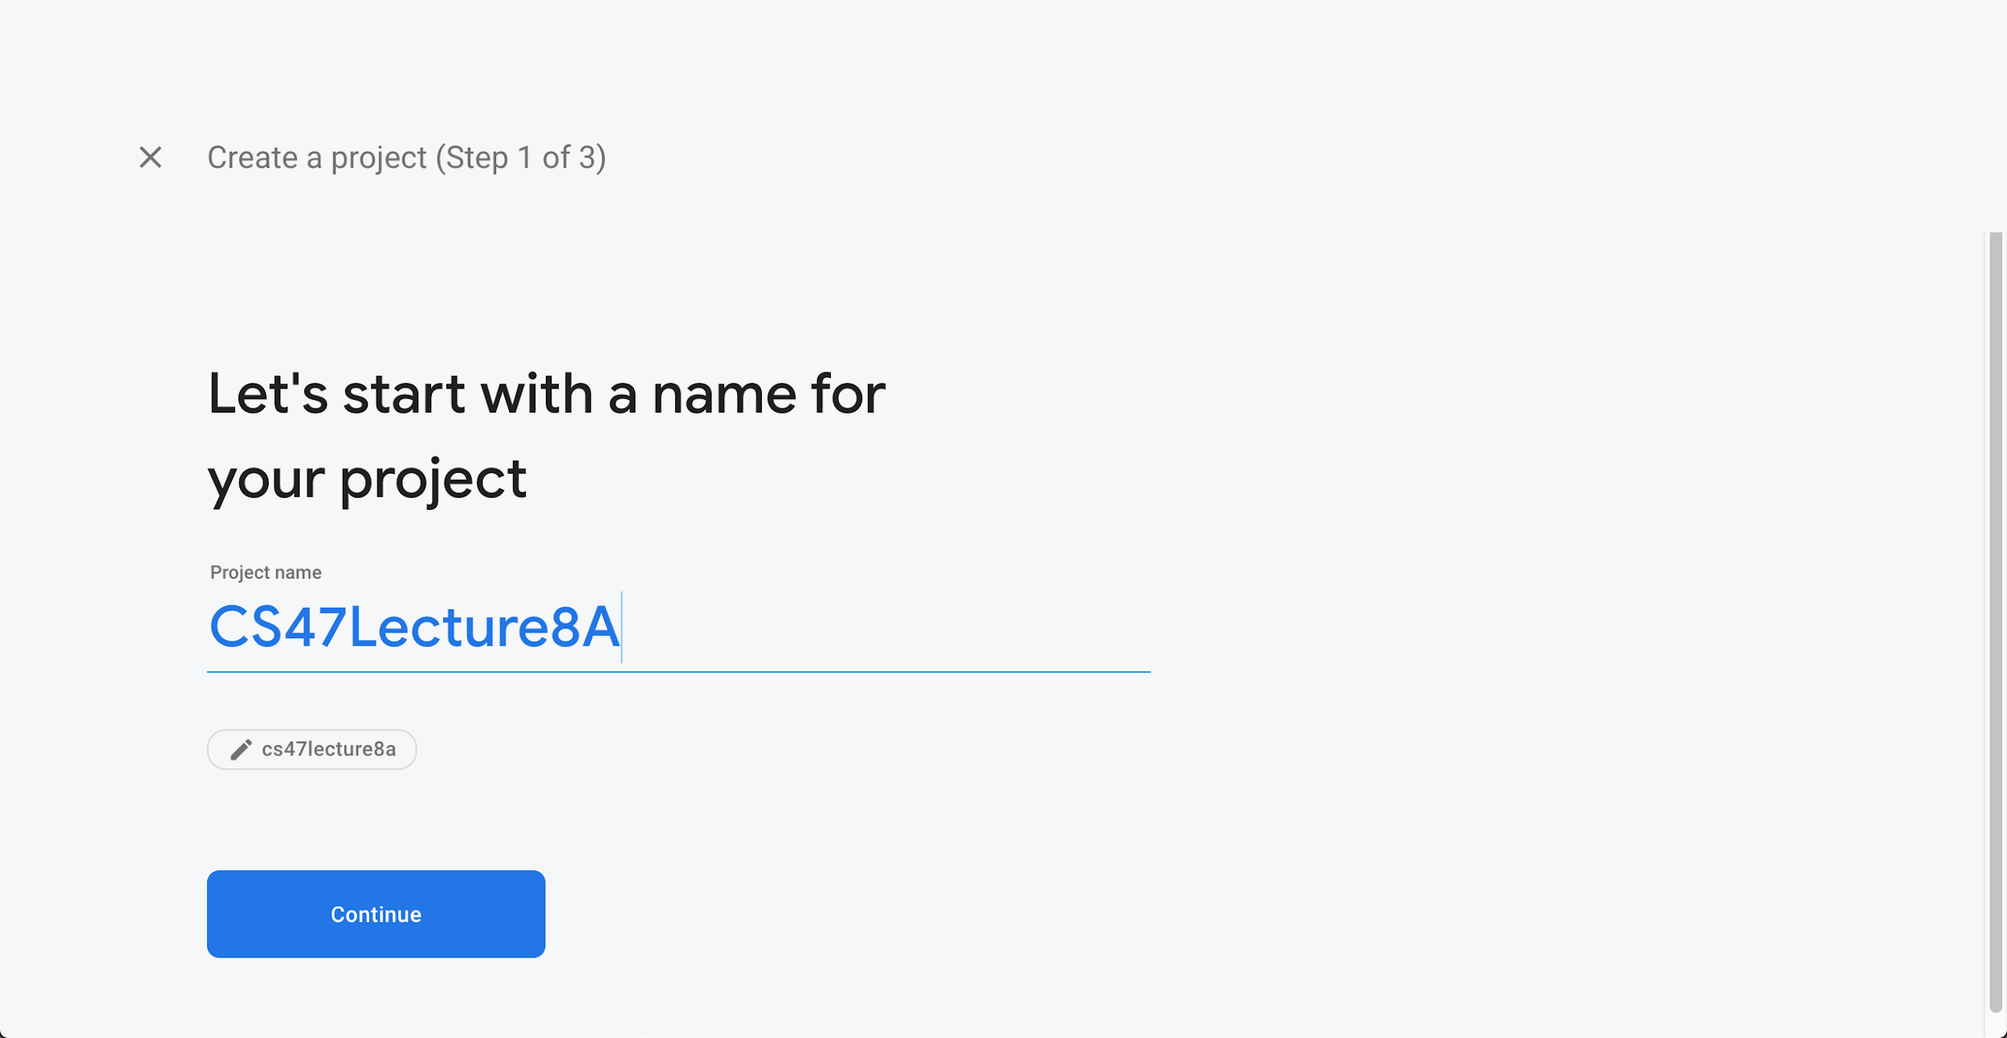
2

Slide 16
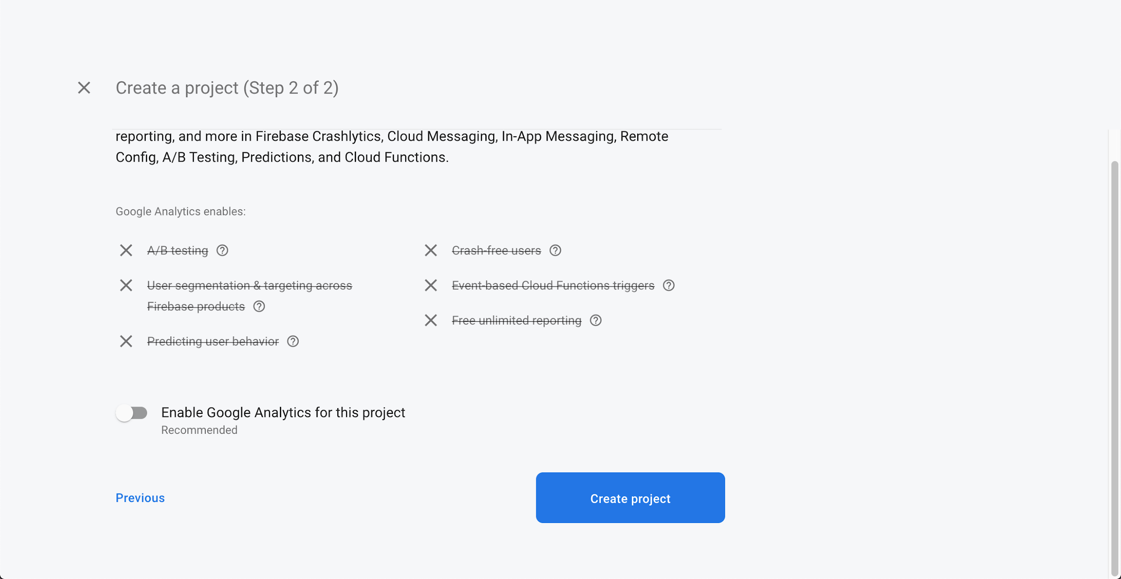
3
(Up to you)

Slide 17
How do you use Firebase Cloud Firestore?
Install Firebase ( npm install --save firebase )
Create a Firebase project
Connect your Firebase project to your app
USEFUL LINKS / Firebase Cloud Firestore Docs

Slide 18
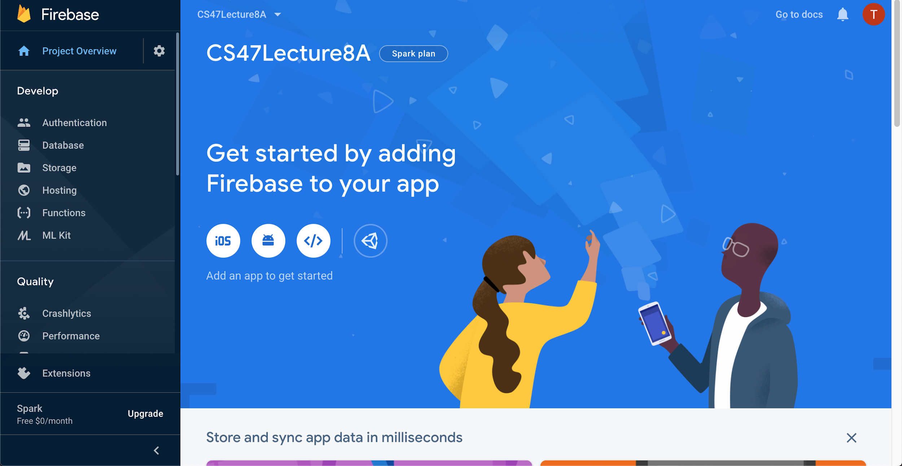
1

Slide 19
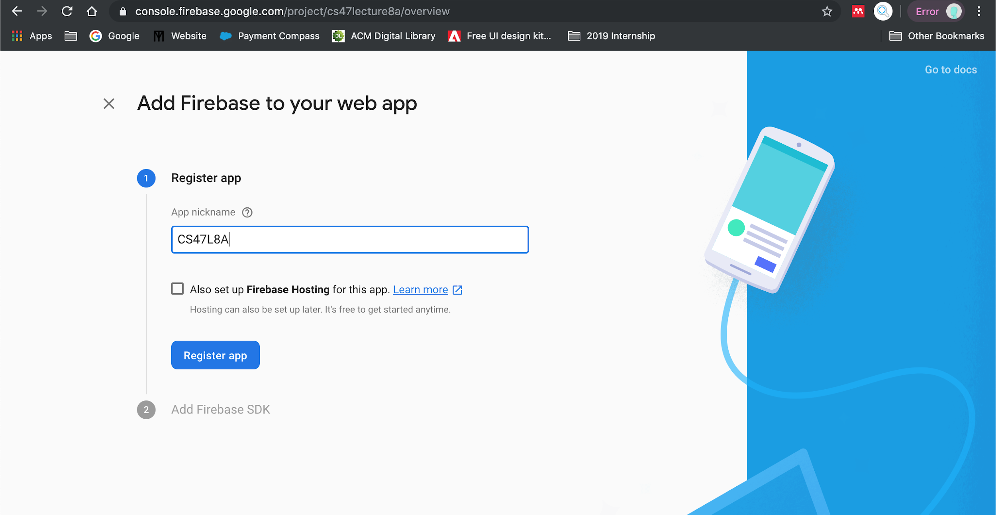
2

Slide 20
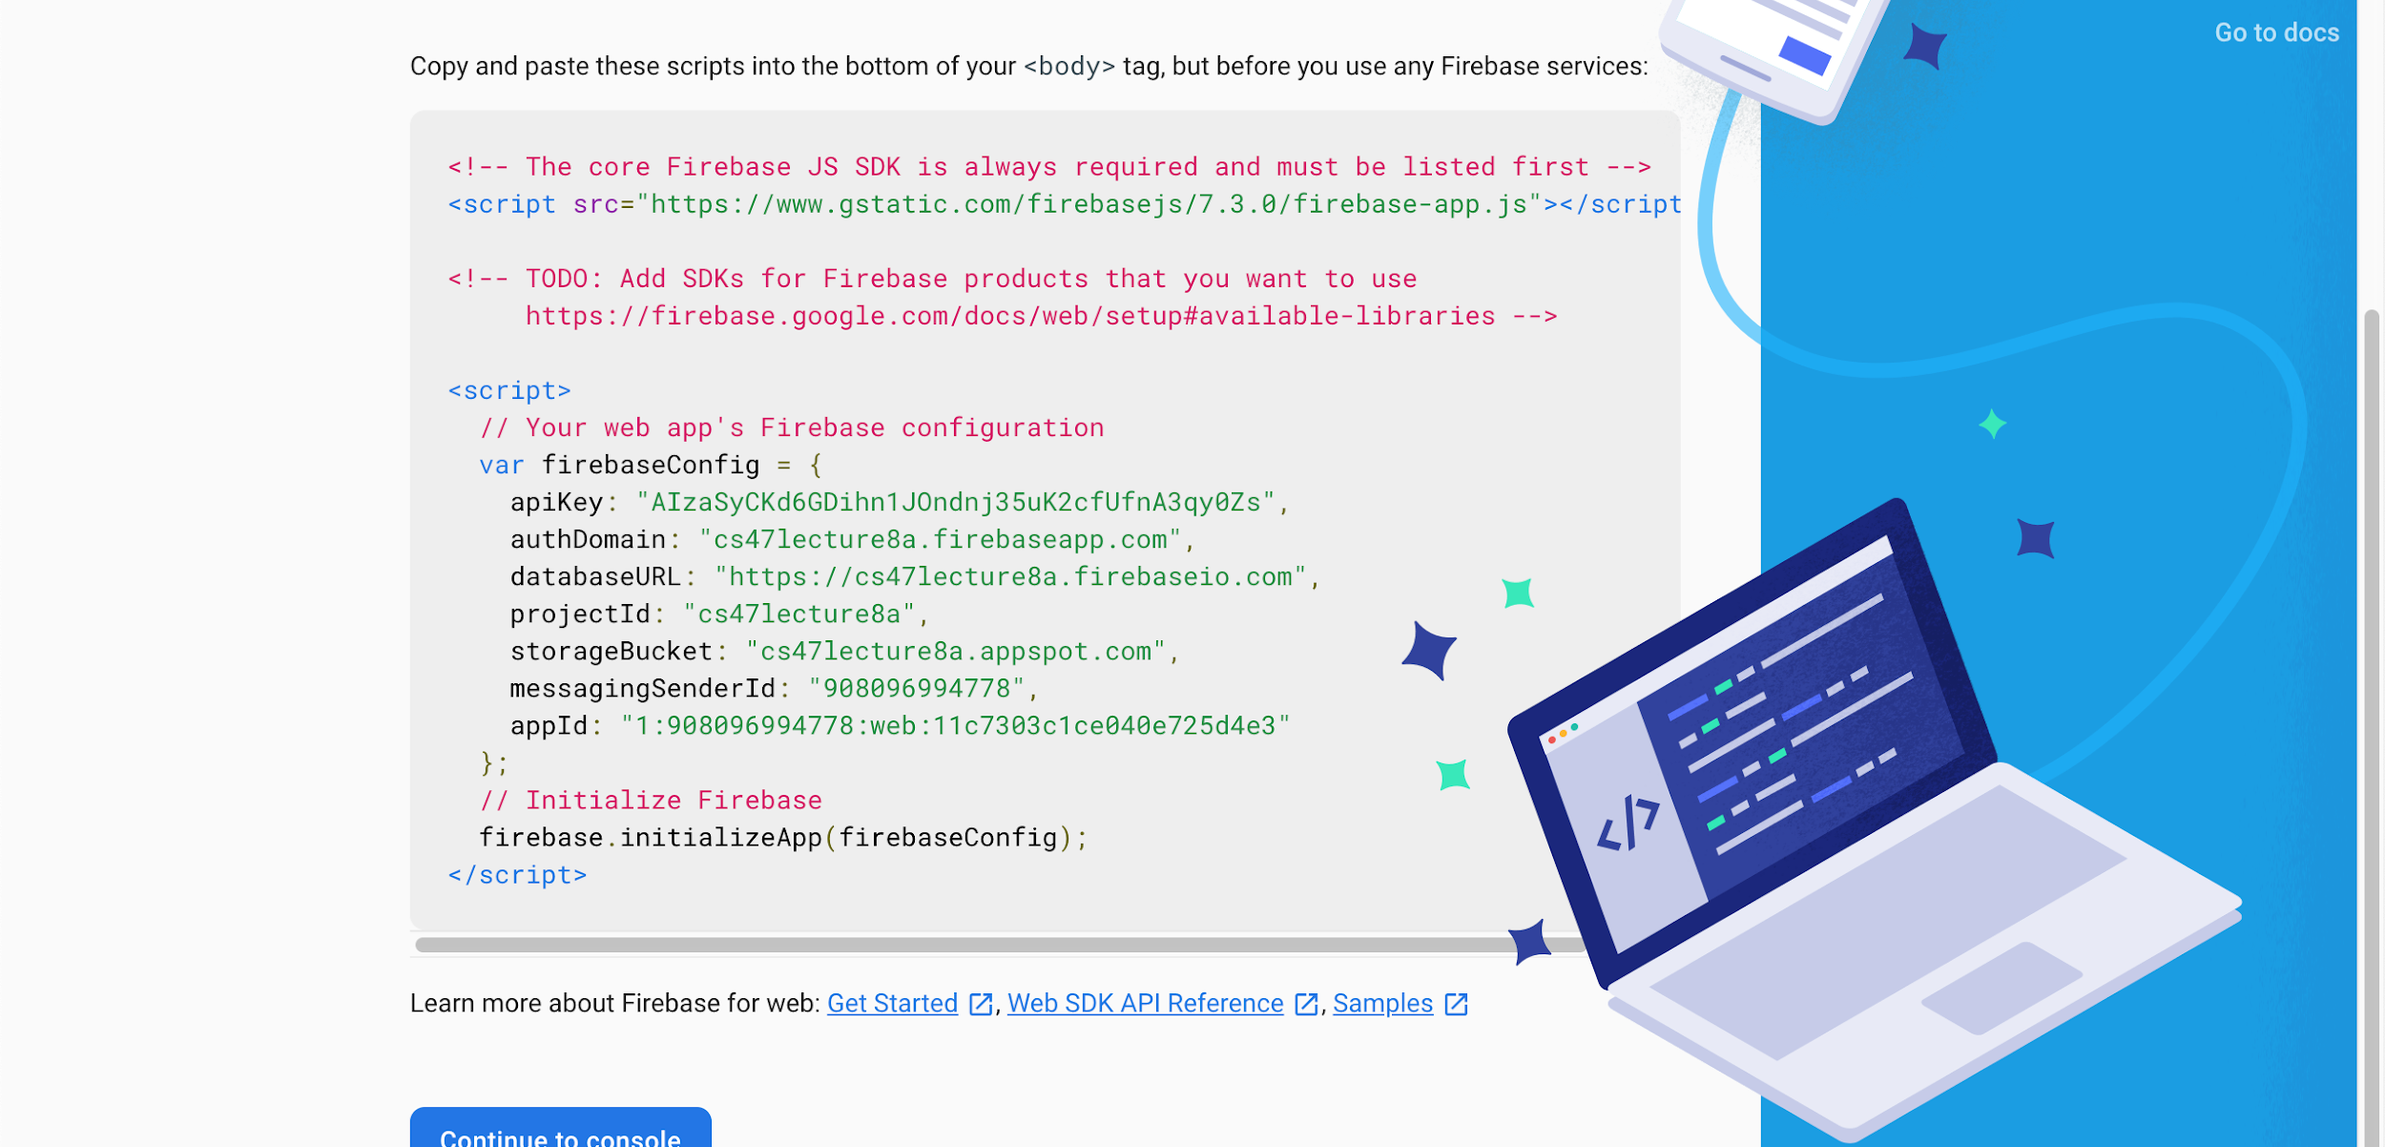
3
Copy code

Slide 21
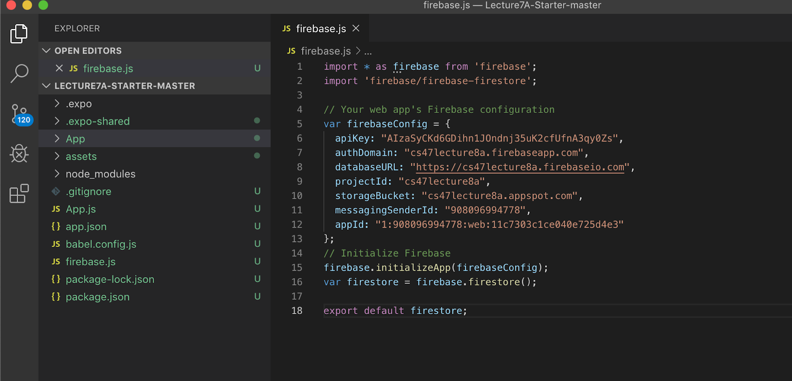
4
Create a firebase.js file and paste code

Slide 22
5
Imports & exports

Slide 23
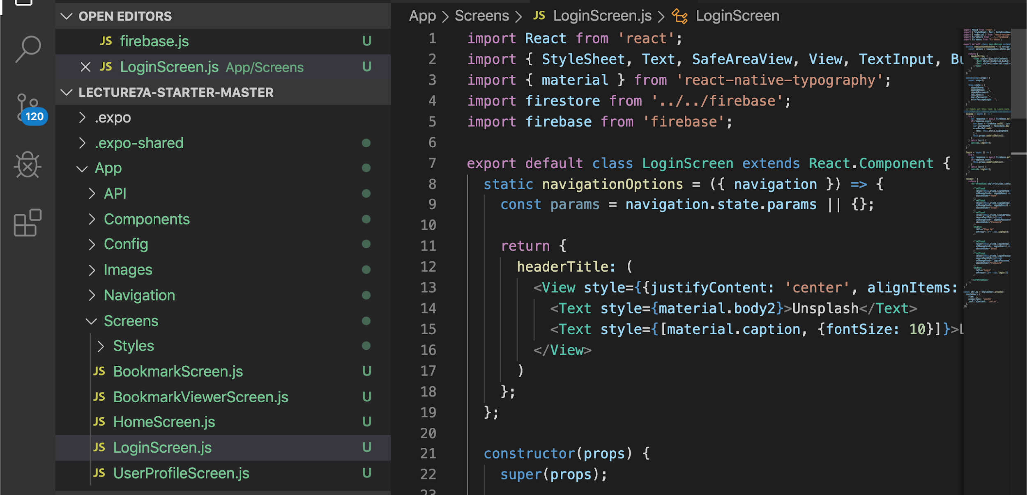
6
Import your Firestore where you need it
Notes:
Note that depending on what you will be doing in the file, you may also need to import firebase again (ex: if you want to do firebase.auth() -- See Slide 32).

Slide 24
How do you use Firebase Cloud Firestore?
Install Firebase ( npm install --save firebase )
Create a Firebase project
Connect your Firebase project to your app
Create a database
Click Develop > Database in the left column of your project console
Click “Create Database”
Select “Start in test mode” (you can change this later) and click “Next”
Click “Done”
USEFUL LINKS / Firebase Cloud Firestore Docs

Slide 25
How do you use Firebase Cloud Firestore?
Install Firebase ( npm install --save firebase )
Create a Firebase project
Connect your Firebase project to your app
Create a database
Add, delete, read, etc. from database!
USEFUL LINKS / Firebase Cloud Firestore Docs

Slide 26
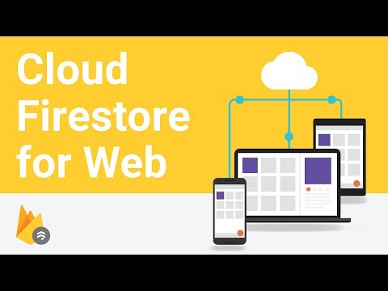
Understanding Collections and Documents
USEFUL LINKS / Firebase Cloud Firestore Docs

Slide 27
Obtain a Reference to a Collection/Document
1
const collRef = firestore.collection(‘collection’)
If the collection is a root collection, pass in the name of the collection (ex: users)
Otherwise, pass in the path to the collection (ex: users/user1/playlist)
const docRef = firestore.doc(‘document’)
You must pass in the path to the document (no root should ever be a document)
This means paths are always in the form collection/document/collection/document/…
USEFUL LINKS / Firebase Cloud Firestore Docs

Slide 28
Perform a Manipulation on that Reference
2
await collRef.add({
key: value,
key: value,
...
});
await docRef.set({
key: value,
key: value,
...
}, { merge: true });
await docRef.update({
key: newValue,
key: newValue,
...
});
Creates an ID for a new document and adds the document to the database
Creates/overwrites document. Merging avoids overwriting existing data.
Updates values of the specified keys. *Check docs to see how to update nested fields + additional shortcuts!
USEFUL LINKS / Firebase Cloud Firestore Docs
Notes:
Remember that this is networking, so you’ll want to use “await” when doing anything with the database.

Slide 29
Perform a Manipulation on that Reference
2
await docRef.delete();
docRef.update({
key: firebase.firestore.FieldValue.delete();
});
Deletes entire document.
Deletes specific field.
USEFUL LINKS / Firebase Cloud Firestore Docs

Slide 30
Read from that Reference
3
let doc = await docRef.get();
if(doc.exists) {
console.log(doc.data)
}
let docs = await collRef.where(“key”, “==”, “value”).get();
docs.forEach((doc) => console.log(doc.data));
let docs = await collRef.get();
docs.forEach((doc) => console.log(doc.data));
Read content of document.
Read multiple/all documents in a collection.
USEFUL LINKS / Firebase Cloud Firestore Docs

Slide 31
Read from that Reference
3
let unsubscribe = docRef.onSnapshot((doc) =>
console.log(doc.data)
);
// Later
unsubscribe();
Get realtime updates by “listening” to document.
*Check docs to see how to listen to multiple documents + how to detect metachanges!
USEFUL LINKS / Firebase Cloud Firestore Docs

Slide 32
Overview for Today
Firebase Overview
Firebase Cloud Firestore
Firebase Authentication
Firebase Exercise

Slide 33
Firebase Authentication
Allows you to confirm a user’s identity and have profiles!
Useful functions
firebase.auth().createUserWithEmailAndPassword(email, password)
firebase.auth().signInWithEmailAndPassword(email, password)
firebase.auth().signOut()
All of the above functions return promises, so you should put “await” before each of them
firebase.auth().onAuthStateChanged((user) => if(user) {// signed in})
Detects whether a user is signed in or not
Returns an unsubscribe function
USEFUL LINKS / Firebase Authentication Docs
Notes:
Walk through starter code to show how logging in works. Have students scan QR code so they can create their own profiles and show them Firebase database updates in realtime.

Slide 34
Overview for Today
Firebase Overview
Firebase Cloud Firestore
Firebase Authentication
Firebase Exercise

Slide 35
Exercise — Implementing Bookmarks
Determine where you will put your Bookmarks collection (Hint: Each user has a different set of bookmarks) (This is conceptual!)
Add a bookmark to the database (FeedItem.js)
Delete a bookmark from the database (FeedItem.js)
Mark the user’s bookmarks by reading from the database (FeedItem.js)
List all of the user’s bookmarks by reading from the database (BookmarkScreen.js)
1
2
3
Following Along
reflect.sh/gigantic-rose
4
STARTER CODE
5
Notes:
Make sure to make your own Firebase project first and copy and paste your new configurations in firebase.js! This will just avoid everyone trying to work on a single database.
Go through step 1 as a class.

Slide 36
Extra Practice — Logging Out
1
Determine where you want to put your “Logout/Sign Out” button in the app
Look at Firebase Authentication documentation to see how to log the current user out
2

Slide 37
CS47: Cross-Platform Mobile Development
Lecture 8A: Firebase Database
Faculty Advisor
Instructor #1
Fall 2019
https://class.website
class.slack.com

